Slide 1
Chapter 2:
Introduction to Ethics

Slide 2
Chapter Overview
1-<number>
Introduction
Review of nine ethical theories
Comparing four ethical theories
Morality of breaking the law

Slide 3
Why Study Ethics?
1-<number>
Ethics: a way to decide the best thing to do
New problems accompany new technologies
“Common wisdom” may not exist for novel situations brought about by new technologies

Slide 4
The Ethical Point of View
Most everyone shares “core values”, desiring:
  Life
  Happiness
  Ability to accomplish goals
Two ways to view world
  Selfish point of view: consider only your own self and your core values
  Ethical point of view: respect other people and their core values
1-<number>

Slide 5
Defining Terms
Society
  Association of people organized under a system of rules
  Rules: advance the good of members over time
Morality
  A society’s rules of conduct
  What people ought / ought not to do in various situations
Ethics
  Rational examination of morality
  Evaluation of people’s behavior
1-<number>

Slide 6
Real – Life Scenario
1-<number>
You are the senior software engineer at a start-up company developing an exciting new product. Your company’s sales force has led a major corporation to believe your product will be available next week.
Unfortunately, at this point the software still contains quite a few bugs. The leader of the testing group has reported that all of the known bugs appear to be minor, but it will take another month of testing for his team to be confident the product contains no catastrophic errors.
Because of the fierce competition in the smartphone software industry, it is critical that your company be “first to market.” To the best of your knowledge, a well-established company will release a similar product in a few weeks. If its product appears first, your start-up company will probably go out of business.

Slide 7
Scenario Questions
1-<number>
Should you recommend release of the product next week?
Who will benefit if the company follows your recommendation?
Who will be harmed if the company follows your recommendation?
Do you have an obligation to any group of people that may be affected by your decision?
What additional information, if any, would help you answer the previous questions?

Slide 8
More on Ethics
1-<number>
Ethics: rational, systematic analysis
  “Doing ethics” means explaining conclusions
  Best explanations based on facts, shared values, logic
Ethics focuses on people’s voluntary, moral choices
Workable ethical theory: produces explanations that might be persuasive to a skeptical, yet open-minded audience

Slide 9
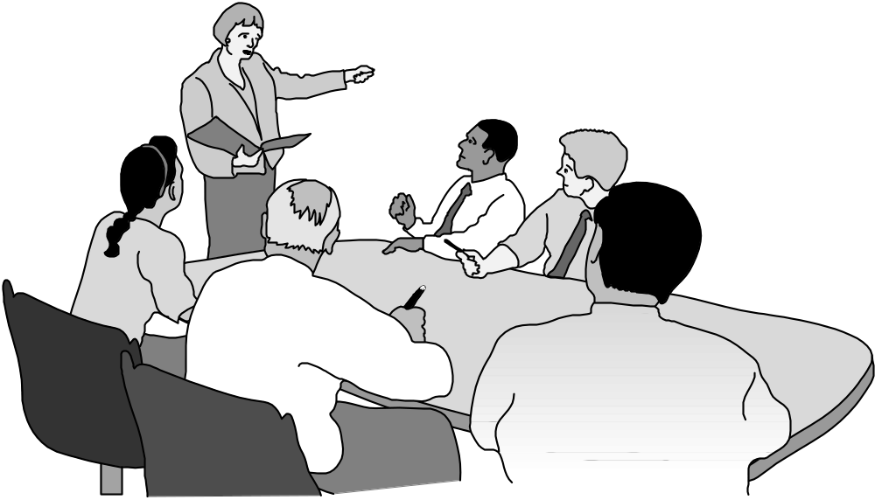
A Good Ethical Theory Supports Persuasive, Logical Arguments
1-<number>

Slide 10
2.2 Subjective Relativism
1-<number>

Slide 11
What Is Relativism?
1-<number>
Relativism
  No universal norms of right and wrong
  One person can say “X is right,” another can say “X is wrong,” and both can be right
Subjective relativism
  Each person decides right and wrong for himself or herself
  “What’s right for you may not be right for me”

Slide 12
Case for Subjective Relativism
1-<number>
Well-meaning and intelligent people disagree on moral issues
Ethical debates are disagreeable and pointless

Slide 13
Case Against Subjective Relativism
1-<number>
Blurs line between doing what you think is right and doing what you want to do
Makes no moral distinction between the actions of different people
SR and tolerance are two different things
Decisions may not be based on reason
Not a workable ethical theory

Slide 14
2.3 Cultural Relativism
1-<number>

Slide 15
Cultural Relativism in a Nutshell
1-<number>
What is “right” and “wrong” depends upon a society’s actual moral guidelines
These guidelines vary from place to place and from time to time
A particular action may be right in one society at one time and wrong in other society or at another time

Slide 16
Case for Cultural Relativism
1-<number>
Different social contexts demand different moral guidelines
It is arrogant for one society to judge another

Slide 17
Case Against Cultural Relativism
1-<number>
Because two societies do have different moral views doesn’t mean they ought to have different views
It doesn’t explain how moral guidelines are determined
What if there are no cultural norms?
It doesn’t account for evolution of moral guidelines.
It provides no way out for cultures in conflict
Existence of many acceptable practices does not imply all practices are acceptable (many/any fallacy)
Societies do, in fact, share certain core values
Only indirectly based on reason
Not a workable ethical theory

Slide 18
2.4 Divine Command Theory
1-<number>

Slide 19
Overview of Divine Command Theory
1-<number>
Good actions: those aligned with God’s will
Bad actions: those contrary to God’s will
Holy books reveal God’s will
We should use holy books as moral decision-making guides

Slide 20
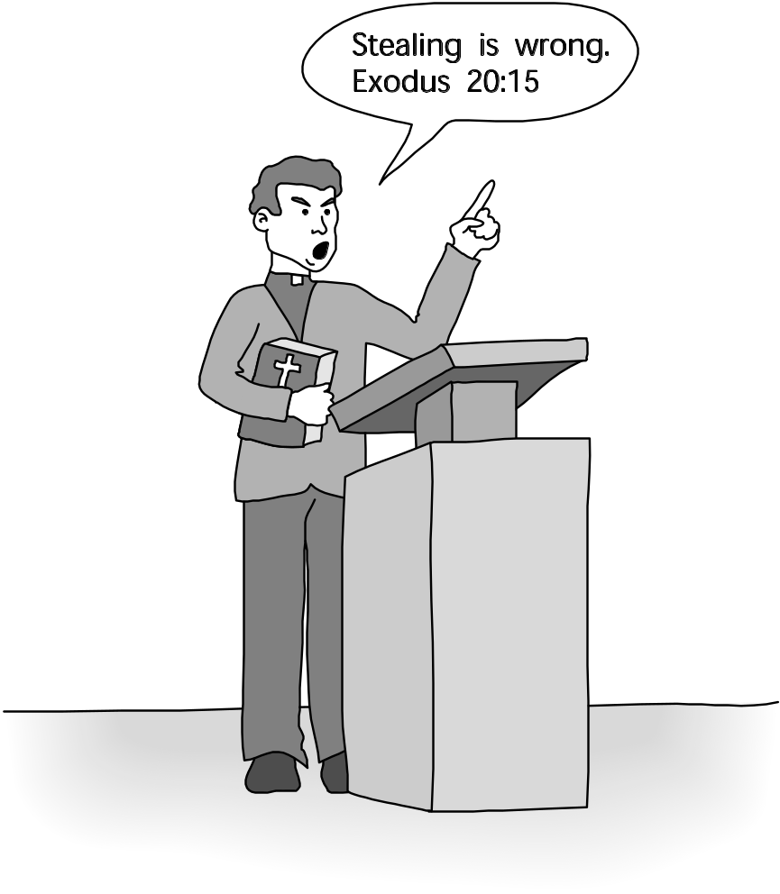
Divine Command Theory in Action
1-<number>

Slide 21
Case for Divine Command Theory
1-<number>
We owe obedience to our Creator
God is all-good and all-knowing
God is the ultimate authority

Slide 22
Case Against Divine Command Theory
1-<number>
Different holy books disagree on certain teachings
Society is multicultural, secular
Some modern moral problems not directly addressed in scripture
“The good” ≠ “God” (equivalence fallacy)
Based on obedience, not reason
Not a workable ethical theory for our purposes

Slide 23
2.5 Ethical Egoism
1-<number>

Slide 24
Definition of Ethical Egoism
1-<number>
Each person should focus exclusively on his or her self-interest
Morally right action: that action that provides self with maximum long-term benefit
Ayn Rand, author of The Fountainhead and Atlas Shrugged, espoused a theory akin to ethical egoism

Slide 25
Case for Ethical Egoism
1-<number>
It is practical since we are already inclined to do what’s best for ourselves
It is better to let other people take care of themselves
The community can benefit when individuals put their well-being first
Other moral principles are rooted in the principle of self-interest

Slide 26
Case Against Ethical Egoism
1-<number>
An easy moral philosophy may not be the best moral philosophy
We know a lot about what is good for someone else
Self-interest can lead to blatantly immoral behavior
Other moral principles are superior to principle of self-interest
People who take the good of others into account lead happier lives
By definition, does not respect the ethical point of view
Not a workable ethical theory

Slide 27
2.6 Kantianism
1-<number>

Slide 28
Critical Importance of Good Will
1-<number>
Good will: the desire to do the right thing
Immanuel Kant: Only thing in the world that is good without qualification is a good will
What we want to do is of no importance. Our focus should be on what we ought to do. This is called dutifulness
Reason should cultivate desire to do right thing

Slide 29
Categorical Imperative (1st Formulation)
1-<number>
A categorical imperative is an unconditional rule: a rule that always applies, regardless of the circumstances.
Act only from moral rules that you can at the
same time will to be universal moral laws.
(Not fair to make exceptions for yourself)

Slide 30
Illustration of 1st Formulation
1-<number>
Question: Can a person in dire straits make a promise with the intention of breaking it later?
Proposed rule: “I may make promises with the intention of later breaking them.”
The person in trouble wants his promise to be believed so he can get what he needs.
Universalize rule: Everyone may make & break promises
Everyone breaking promises would make promises unbelievable, contradicting desire to have promise believed
The rule is flawed. The answer is “No.”

Slide 31
A Quick Check
1-<number>
When evaluating a proposed action, reverse roles
What would you think if that person did the same thing to you?
Negative reaction → evidence that your will to do that action violates the Categorical Imperative

Slide 32
Categorical Imperative (2nd Formulation)
1-<number>
Act so that you treat both yourself
and other people as ends in themselves
and never only as a means to an end.
Means implies using only for your own benefit, with no thought to the interests or benefit of the thing that you are using.
Humans are ends-in-themselves

Slide 33
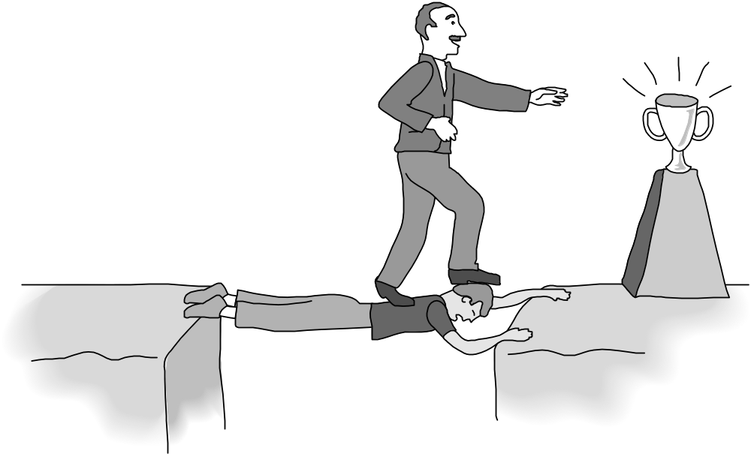
Kant: Wrong to Use Another Person Solely as a Means to an End
1-<number>

Slide 34
Plagiarism Scenario
1-<number>
Carla
  Single mother
  Works full time
  Takes two evening courses/semester
History class
  Requires more work than normal
  Carla earning an “A” on all work so far
  Carla doesn’t have time to write final report
Carla purchases report; submits it as her own work

Slide 35
Kantian Evaluation (1st Formulation)
1-<number>
Carla wants credit for plagiarized report
Rule: “You may claim credit for work performed by someone else”
If rule universalized, reports would no longer be credible indicator’s of student’s knowledge, and professors would not give credit for reports
Proposal moral rule is self-defeating
It is wrong for Carla to turn in a purchased report

Slide 36
Kantian Evaluation (2nd Formulation)
1-<number>
Carla submitted another person’s work as her own
She attempted to deceive professor
She treated professor as a means to an end
  End: passing the course
  Means: manipulate professor
What Carla did was wrong

Slide 37
Case for Kantianism
1-<number>
Aligns with common moral concern: “What if everyone acted that way?”
Produces universal moral guidelines
Treats all persons as moral equals

Slide 38
Perfect and Imperfect Duties
1-<number>
Perfect duty: duty obliged to fulfill without exception
  Example: Telling the truth
Imperfect duty: duty obliged to fulfill in general but not in every instance
  Example:
  1. Duty of self-improvement.
  2. Duty to aid others.

Slide 39
Case Against Kantianism
1-<number>
Sometimes no rule adequately characterizes an action. Eg: stealing to feed starving children
Sometimes there is no way to resolve a conflict between rules
  In a conflict between a perfect duty and an imperfect duty, perfect duty prevails
  In a conflict between two perfect duties, no solution
  Eg: never tell a lie and avoid harming someone
Kantianism allows no exceptions to perfect duties
Commending someone for a dress.

Slide 40
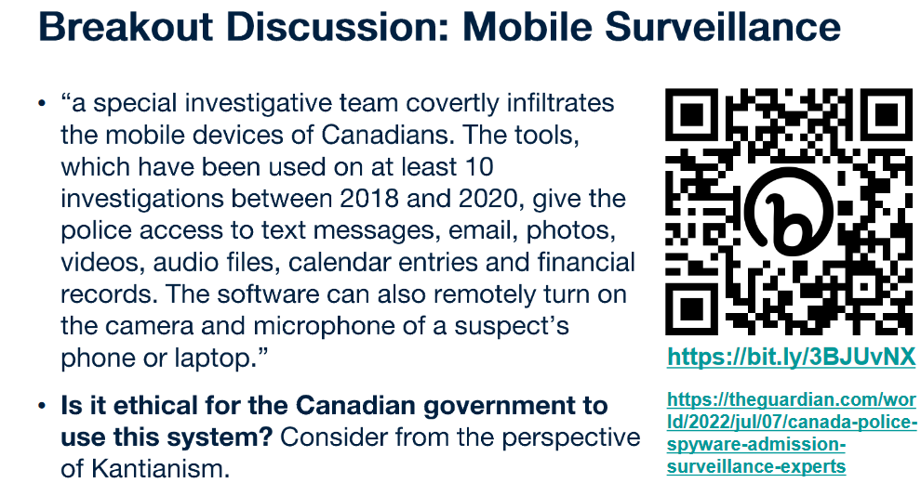


Slide 41
2.7 Act Utilitarianism
1-<number>
Notes:
such as never tell a lie and avoid harming someone

Slide 42
Principle of Utility
1-<number>
Jeremy Bentham and John Stuart Mill
An action is good if its benefits exceeds its harms
An action is bad if its harms exceed its benefits
Utility: tendency of an object to produce happiness or prevent unhappiness for an individual or a community
Happiness = advantage = benefit = good = pleasure
Unhappiness = disadvantage = cost = evil = pain

Slide 43
Principle of Utility
(Greatest Happiness Principle)
1-<number>
An action is right (or wrong) to the extent
that it increases (or decreases) the
total happiness of the affected parties.

Slide 44
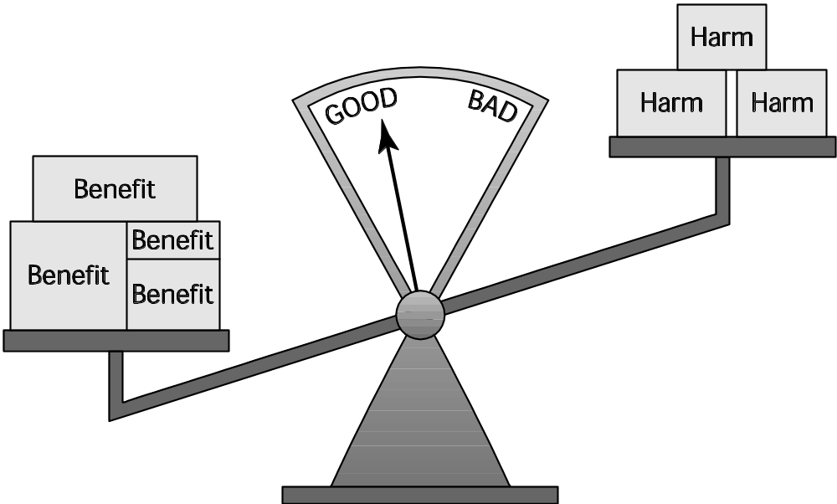
Principle of Utility
1-<number>

Slide 45
Act Utilitarianism
1-<number>
Utilitarianism
  Morality of an action has nothing to do with intent
  Focuses on the consequences
  A consequentialist theory
Act utilitarianism
  Add up change in happiness of all affected beings
  Sum > 0, action is good
  Sum < 0, action is bad
  Right action to take: one that maximizes the sum

Slide 46
2.8 Rule Utilitarianism
1-<number>
The case of organ transplant for 5 (useful members of society) patients from one lesser member of society.
Refrain from acts that might maximize utility in the short run and instead follow rules that will maximize utility for the majority of the time

Slide 47
Applying Principle of Utility to Rules
1-<number>
We ought to adopt moral rules which, if followed by everyone, will lead to the greatest increase in total happiness
Act utilitarianism applies Principle of Utility to individual actions
Rule utilitarianism applies Principle of Utility to moral rules

Slide 48
Anti-Worm Scenario
1-<number>
August 2003: Blaster worm infected thousands of Windows computers
Soon after, Nachi worm appeared
  Took control of vulnerable computer
  Located and destroyed copies of Blaster
  Downloaded software patch to fix security problem
  Used computer as launching pad to try to “infect” other vulnerable PCs

Slide 49
Evaluation using Rule Utilitarianism
1-<number>
Proposed rule: If I can write a helpful worm that removes a harmful worm from infected computers and shields them from future attacks, I should do so
Who would benefit
  People who do not keep their systems updated
Who would be harmed
  People who use networks
  People who’s computers are invaded by buggy anti-worms
  System administrators
Conclusion: Harm outweighs benefits. Releasing anti-worm is wrong.

Slide 50
Case for Rule Utilitarianism
1-<number>
Not every moral decision requires performing utilitarian calculus
Moral rules survive exceptional situations
Avoids the problem of moral luck
Reduces the problem of bias
Appeals to a wide cross-section of society

Slide 51
Case Against Utilitarianism in General
1-<number>
All consequences must be measured on a single scale.
  All units must be the same in order to do the sum
  In certain circumstances utilitarians must quantify the value of a human life
Utilitarianism ignores the problem of an unjust distribution of good consequences.
  Utilitarianism does not mean “the greatest good of the greatest number”
  That requires a principle of justice
  What happens when a conflict arises between the Principle of Utility and a principle of justice?

Slide 52
2.9 Social Contract Theory
1-<number>

Slide 53
Basis of Social Contract Theory
1-<number>
Thomas Hobbes
  Lived during the English Civil War (1600s)
  In a “state of nature” our lives would be “solitary, poor, nasty, brutish, and short”
  We implicitly accept a social contract
    Establishment of moral rules to govern relations among citizens
    Government capable of enforcing these rules
Jean-Jacques Rousseau
  In ideal society, no one above rules
  That prevents society from enact bad rules

Slide 54
James Rachels’s Definition
1-<number>
“Morality consists in the set of rules,
governing how people are to
treat one another, that rational
people will agree to accept, for their
mutual benefit, on the condition that
others follow those rules as well.”

Slide 55
Kinds of Rights
(Classified according to the duties they put on others)
1-<number>
Negative right: A right that another can guarantee by leaving you alone or limiting action against you
  Eg: The right to privacy, the right not to be killed, or the right to do what one wants with one's property
Positive right: A right obligating others to do something on your behalf
  Eg: right to a free education
Absolute right: A right guaranteed without exception
  Eg: the right to life
Limited right: A right that may be restricted based on the circumstances. Typically, positive rights are considered to be limited rights.
  Eg: Free education till 12th grade

Slide 56
John Rawls’s Principles of Justice
1-<number>
Each person may claim a “fully adequate” number of basic rights and liberties, so long as these claims are consistent with everyone else having a claim to the same rights and liberties
Any social and economic inequalities must
  Be associated with positions that everyone has a fair and equal opportunity to achieve
  Be to the greatest benefit of the least-advantaged members of society (the difference principle)

Slide 57
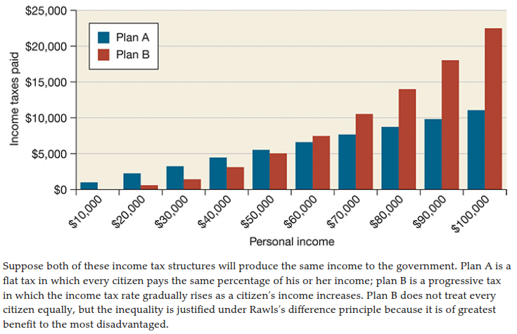
Rawls’s Difference Principle
1-<number>

Slide 58
Rawls’s Difference Principle
Social and economic inequalities must be justified. The only way to justify a social or economic inequality is to show that its overall effect is to provide the most benefit to the least advantaged.
An example is a graduated income tax system in which people with higher incomes pay a higher percentage of their income in taxes (See Figure on next page ).
A violation of the difference principle would be a military draft system in which poor people had a higher probability of being drafted than wealthy people.

Slide 59
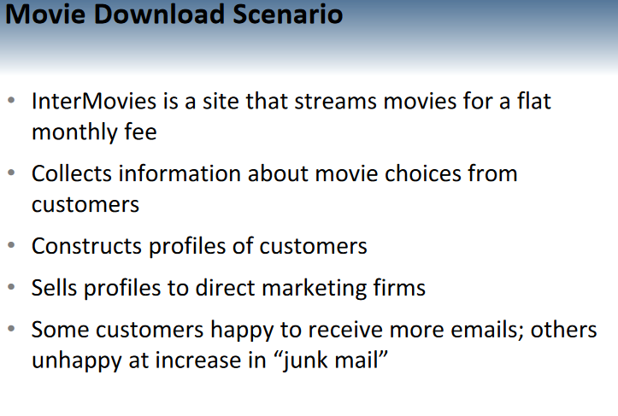
1-<number>

Slide 60
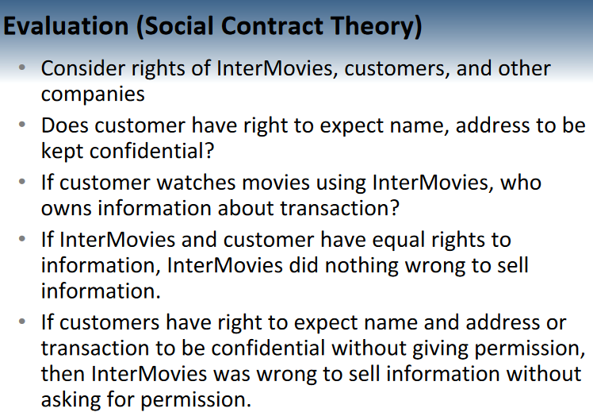
1-<number>

Slide 61
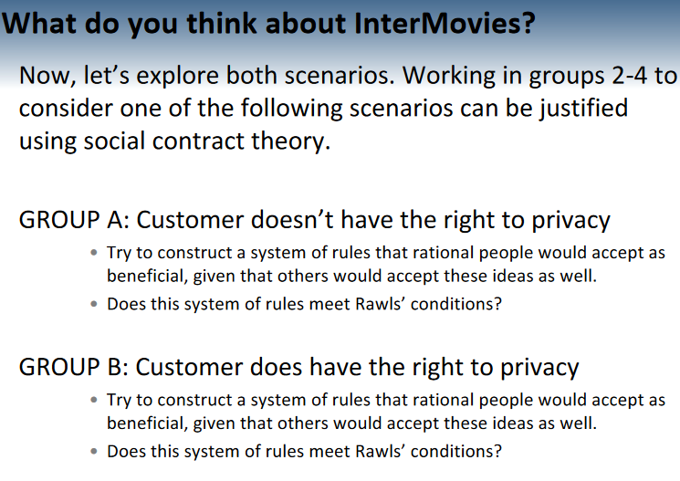

Slide 62
Case for Social Contract Theory
1-<number>
Framed in language of rights
Explains why people act in self-interest in absence of common agreement
Provides clear analysis of certain citizen/government problems
  Why civil obedience can be morally right action

Slide 63
Case Against Social Contract Theory
1-<number>
No one signed social contract
Some actions have multiple characterizations
Eg: Stealing food from a grocery store to feed my starving children
Conflicting rights problem
May unjustly treat people incapable of upholding contract

Slide 64
2.10 Virtue Ethics
1-<number>

Slide 65
Critique of Enlightenment Theories
1-<number>
Kantianism, utilitarianism, social contract theory ignore important moral considerations
  moral education
  moral wisdom
  family and social relationships
  role of emotions
Virtue ethics
A good person does “the right thing at the right time for the
right reason”

Slide 66
Virtues and Vices
1-<number>
Two types of virtue
  intellectual virtues: virtues associated with reasoning and truth
  moral virtues: virtues of character (e.g., honesty)
Moral virtues
  developed by habitually performing right action
  deep-seated character traits
  disposition to act in a certain way and feel in a certain way

Slide 67
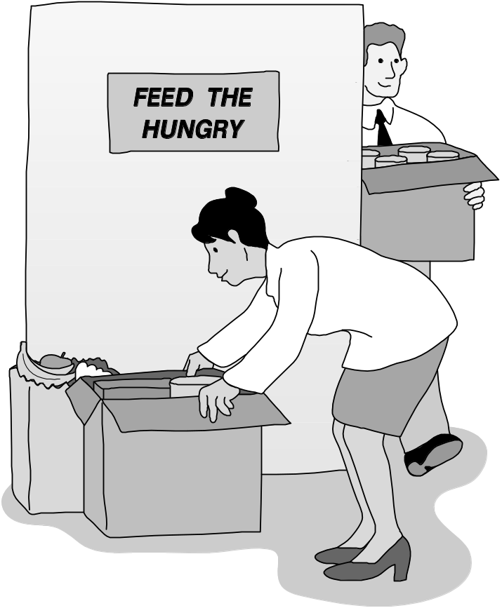
Aristotle: Happiness derives from living a life of virtue.
1-<number>

Slide 68
Summary of Virtue Ethics
1-<number>
A right action is an action that a virtuous person, acting in character, would do in the same circumstances.
A virtuous person is a person who possesses and lives out the virtues.
The virtues are those character traits human beings needs in order to flourish and be truly happy.

Slide 69
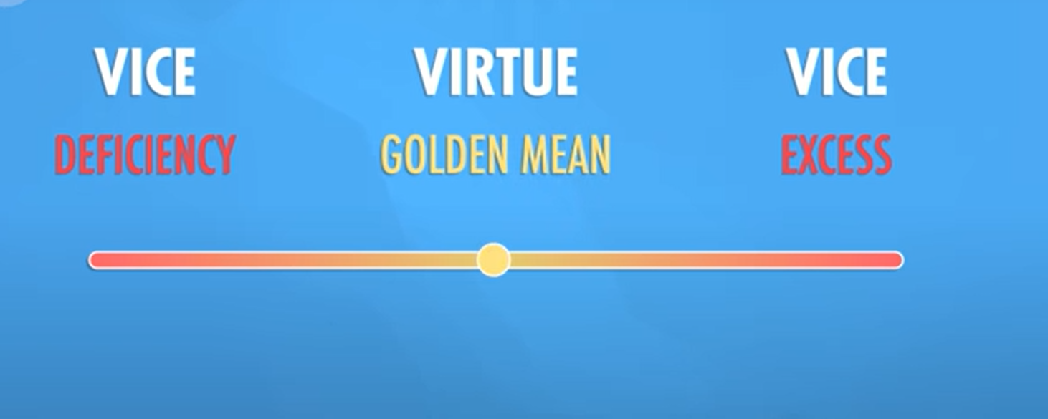

Slide 70
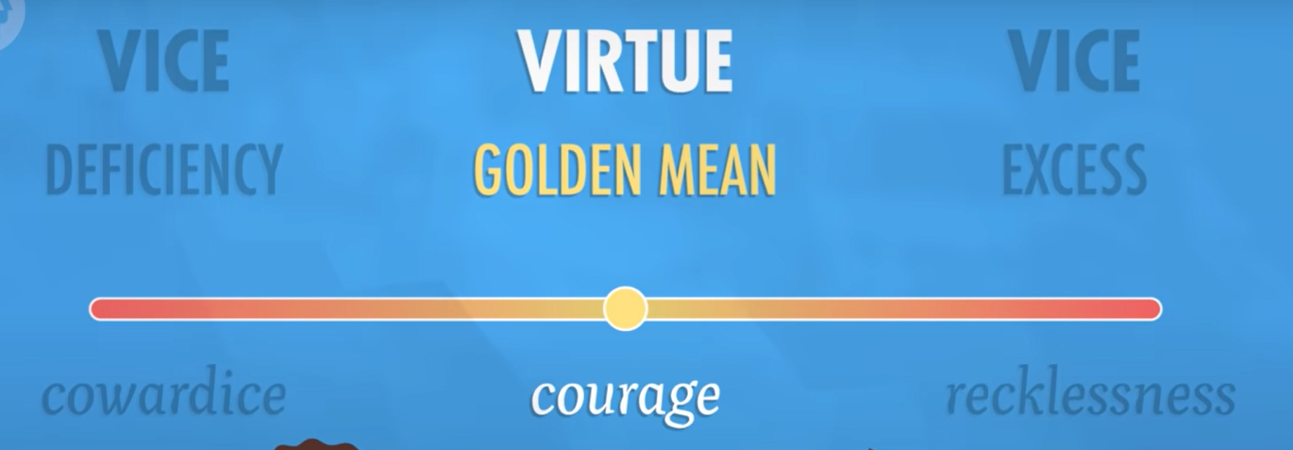

Slide 71
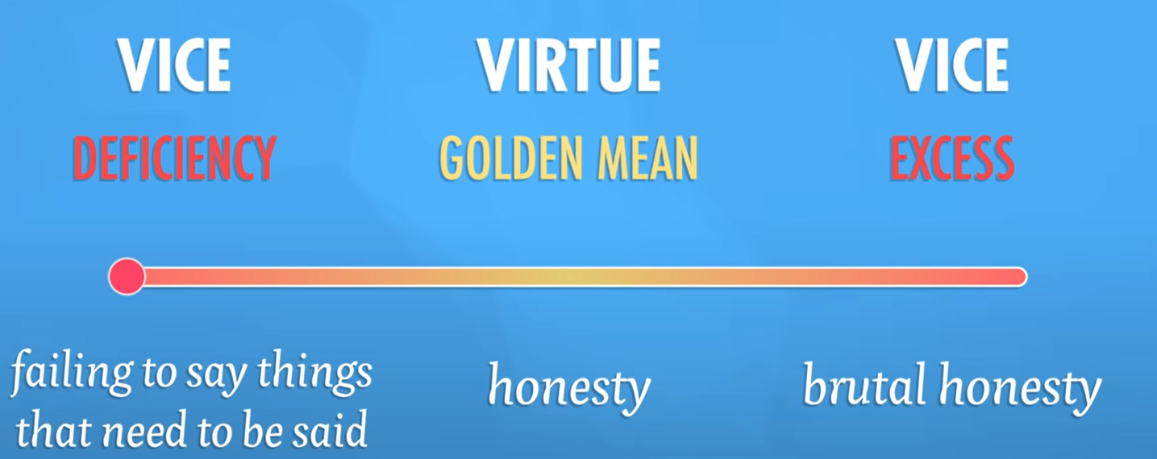

Slide 72
Vices
1-<number>
Vices are opposite of virtues
Vice: a character trait that prevents a human being from flourishing or being truly happy
Often, a virtue situated between two vices
  Courage between cowardliness and rashness
  Generosity between stinginess and prodigality

Slide 73
Case for Virtue Ethics
1-<number>
It often makes more sense to focus on virtues than obligations, rights, or consequences
Personal relationships can be morally relevant to decision making
Our moral decision-making skills develop over time
With this theory there are no irresolvable moral dilemmas
Emotions play an important role in living a moral life

Slide 74
Case Against Virtue Ethics
1-<number>
Reasonable people may disagree on character traits needed for human flourishing
Cannot use virtue ethics to guide government policy
Virtue ethics undermines attempts to hold people responsible for their bad actions

Slide 75
2.11 Comparing Ethical Theories
1-<number>

Slide 76
Objectivism vs. Relativism
1-<number>
Objectivism: Morality has an existence outside the human mind
Relativism: Morality is a human invention
Divine command theory, ethical egoism, Kantianism, utilitarianism, social contract theory, and virtue ethics examples of objectivism

Slide 77
Workable Ethical Theories
1-<number>
We seek theories with these characteristics:
  Based on the ethical point of view
  Objective moral principles developed using logical reasoning based on facts and commonly held values
Workable ethical theories
  Kantianism
  Act and rule utilitarianism
  Social contract theory
  Virtue ethics

Slide 78
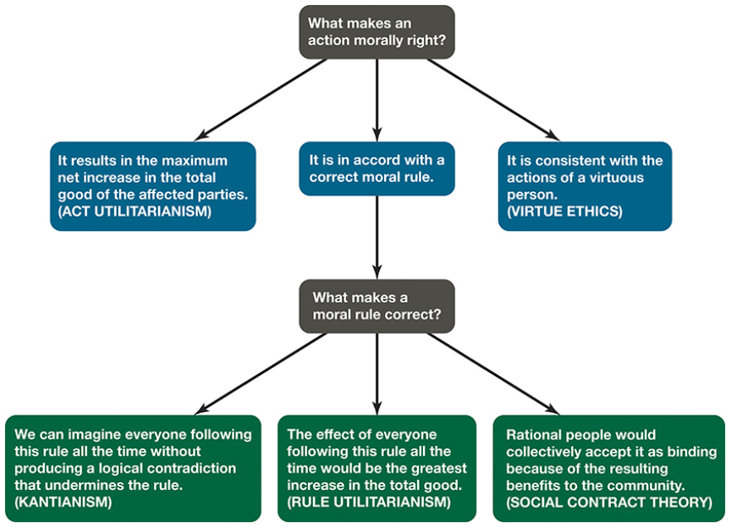
Comparing Ethical Theories
1-<number>

Slide 79
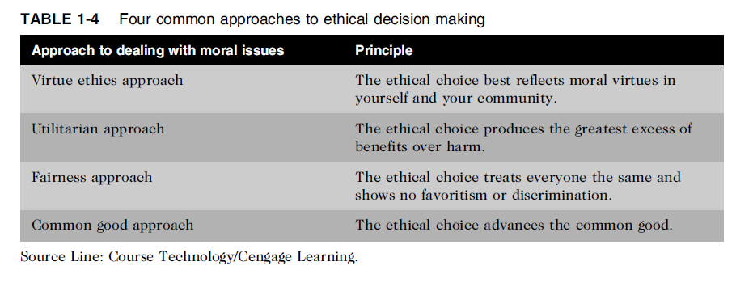
Common Approaches to Ethical Decision Making
Table 1-5 Four common approaches to ethical decision making

Slide 80
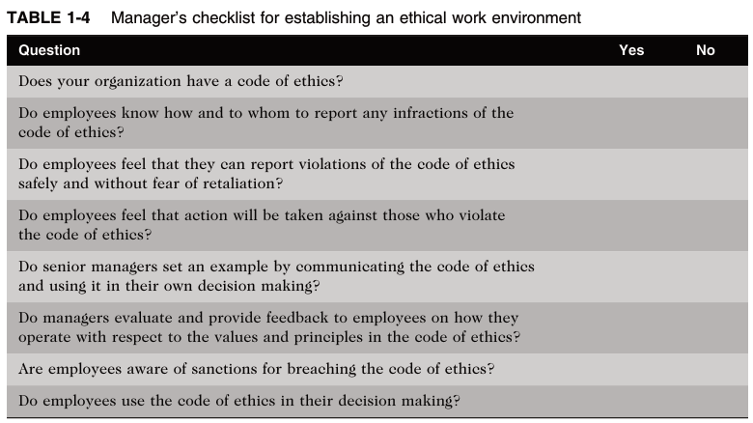

Slide 81
What trends have increased the likelihood of an unethical behavior?
Globalization has created a much more complex work environment, making it more difficult to apply principles and codes of ethics consistently.
Organizations may be tempted to resort to unethical behavior to maintain profits in today’s more challenging and uncertain economic climate.
It is not unusual for powerful, highly successful individuals to fail to act in morally appropriate ways as such people are often aggressive in striving for what they want and are used to having privileged access to information, people, and other resources.
Furthermore, their success often inflates their belief that they have the ability and the right to manipulate the outcome of any situation.

Slide 82
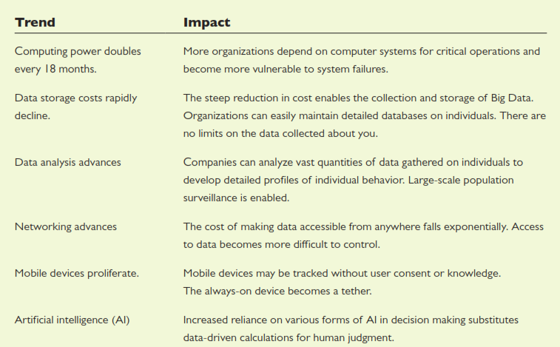
Technology Trends that Influence Ethical Issues

